Slide 1




N. K. Orchid College Of Engineering and Technology, Solapur
By Computer Science Engineering Students
Association(CSESA)
Orchathon 2k26
QuantSolve – The Algebraic Parser &Equation Engine
Finance Tech
Team Detail : # Sayali Pawar – Powerpoint Presentation
# Sandhya Jorve – Powerpoint Presentation
# Sanika Shahane – Frontend &Backend
# Prajakta Shirole – Data Lead
Institution : Amrutvahini Enginering College, Sangamner

Slide 2




PROBLEM STATEMENT
Overview of the Problem
In quantitative finance, traders need to allocate budgets across multiple assets efficiently
Existing tools perform only basic calculations and cannot solve complex multi-variable problems
This project proposes a custom Algebraic Parser & Equation Engine
The system reads user-input equations, understands algebra, and generates all valid whole-number solutions
It ensures the budget is fully utilized without any leftover amount
Objective of the Project
The main objective of this project is to develop a custom Algebraic Parser and Equation Engine that can understand and solve user-defined mathematical equations. The system is designed to generate all possible whole-number solutions for multi-variable problems and help in efficient budget allocation without any leftover amount. It also applies constraints to provide accurate and practical results for real-world financial applications.

Slide 3
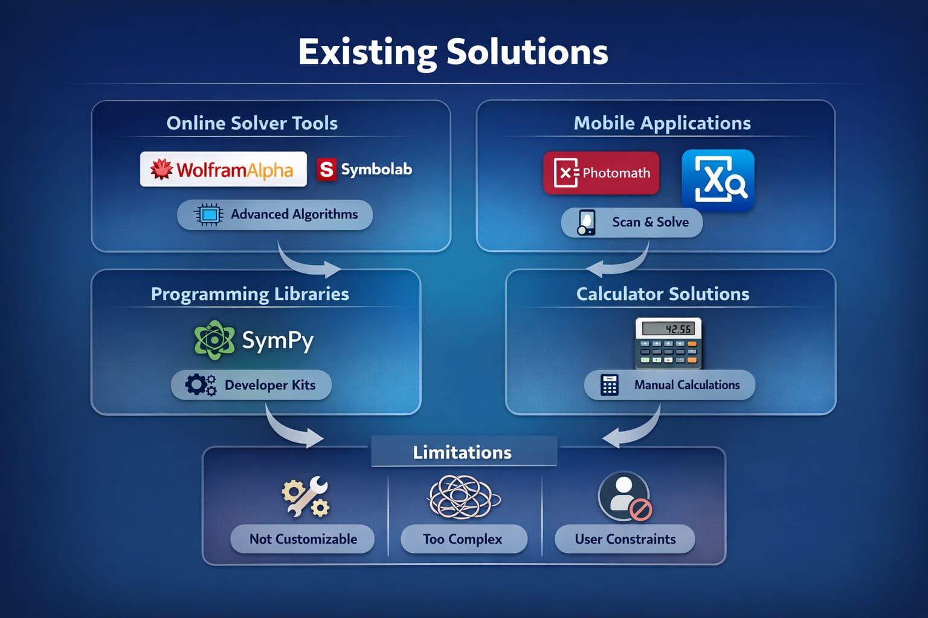
PROPOSED SOLUTION
Developed a custom algebraic parser & solver
Converts raw text into structured mathematical form
Computes all valid combinations efficiently
Integrates constraints like limits and conditions

Slide 4
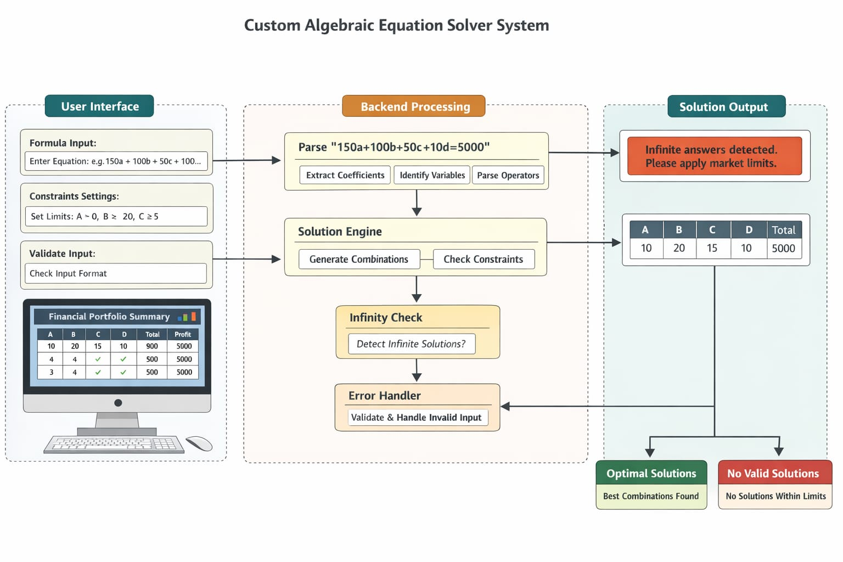
SYSTEM ARCHITECTURE
Input Layer: User enters equation
Parser Engine: Breaks equation into variables & coefficients
Solver Engine: Finds all valid solutions
Rule Engine: Applies constraints
Output Layer: Displays results in dashboard

Slide 5
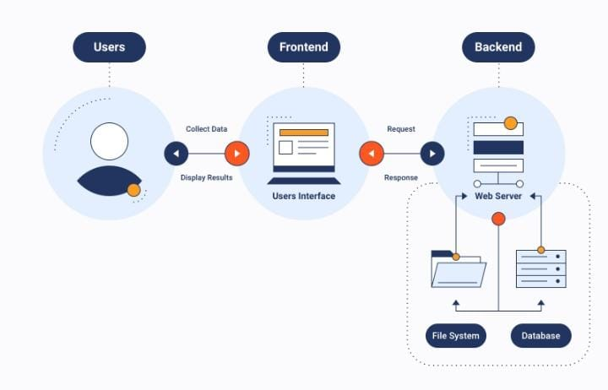
TECHNOLOGY STACK
Backend: Python
Frontend: HTML, CSS
Framework: Flask
Core Logic: Custom Parser & Solver (no eval() or pre-built libraries)
“The system uses a modern full-stack approach with a
custom-built algorithm engine.”

Slide 6
CORE FEATURES &
BENEFITS
⚡
ADVANTAGES
📈
LIMITATION
Faster than brute-force methods
Scalable for multiple variables
User-friendly financial tool
Handles real-world trading scenarios
Supports only linear equation.
Basics user interface features.
Requires constraints to avoid infinite solutions.

Slide 7
🏁
CONCLUSION
Successfully built a custom algebra engine
Efficiently solves complex financial allocation problems
Can be extended for real trading systems

Slide 8


